Slide 1
C++ Basics relevant to CSI 228
Fariha Tabassum Islam

Slide 2
Basics
C++ language extends the C programming language with additional features such as type checking, object-oriented programming, exception handling etc.
C++ was developed by Bjarne Stroustrup in 1979.
File extension .cpp
Why C++ in this course?
The Standard Template Library (STL) of C++ provides useful codes
STL is a set of C++ template classes to provide common programming data structures and functions such as lists, stacks, arrays, etc. It is a library of container classes, algorithms, and iterators.

Slide 3
Similarities with C
Variables, Operators
struct
Array
Function
Pointer
Strings
If, if…else-if statement, switch case, for loop, while loop, do-while loop, continue statement, break statement, goto statement
Recursion
can use the same code as written in c

Slide 4
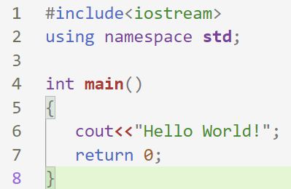
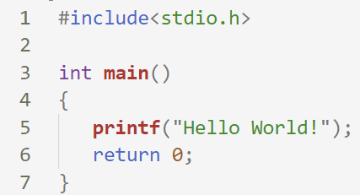
Basics
C++
C
for details explanation: https://beginnersbook.com/2017/08/first-cpp-program/

Slide 5
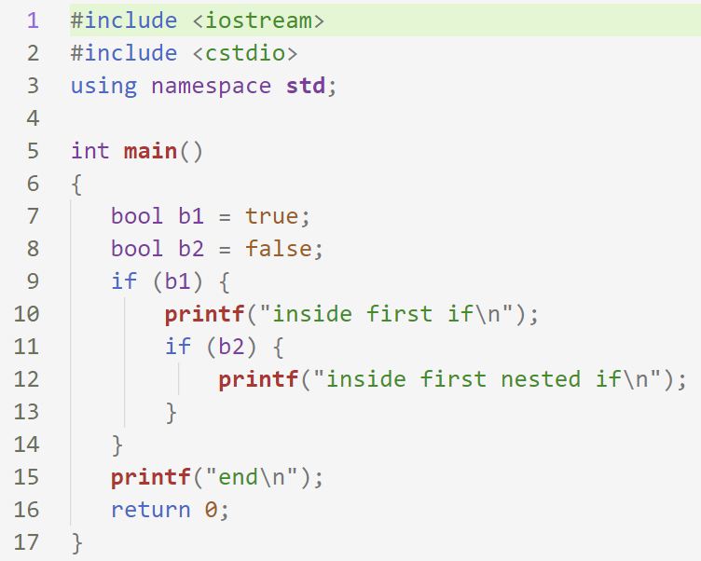
Variables and Data types
Output:
inside first if
end
int
char
bool
holds Boolean value true or false
double
float
inside first if
end

Slide 6
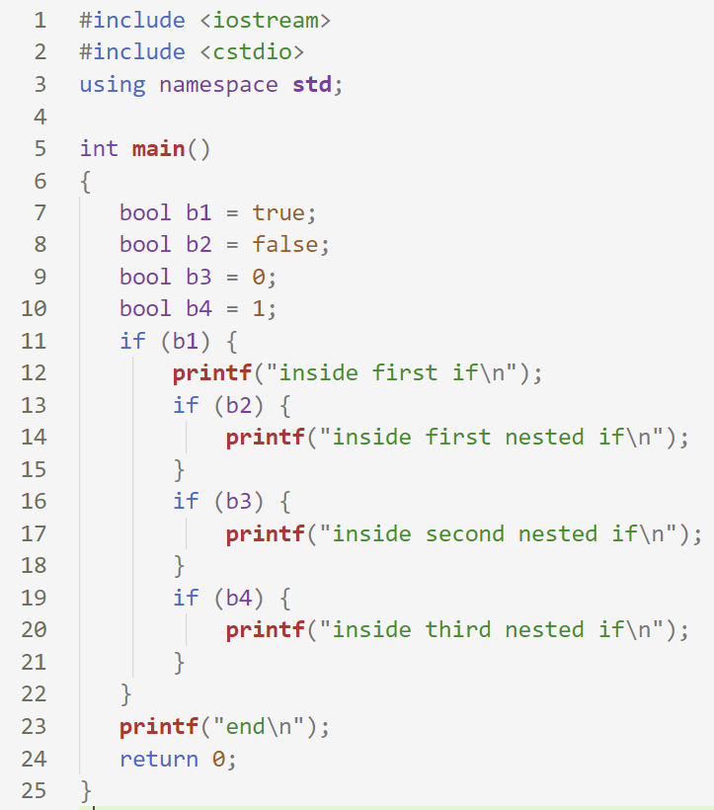
Variables and Data types
Output:
inside first if
inside third nested if
end

Slide 7
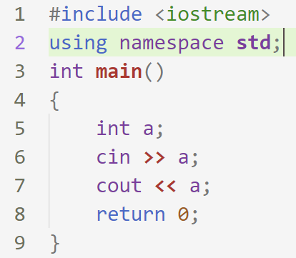
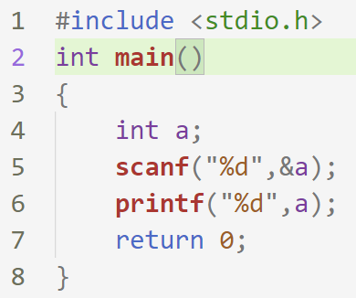
scanf(), printf() equivalent
C++
C

Slide 8
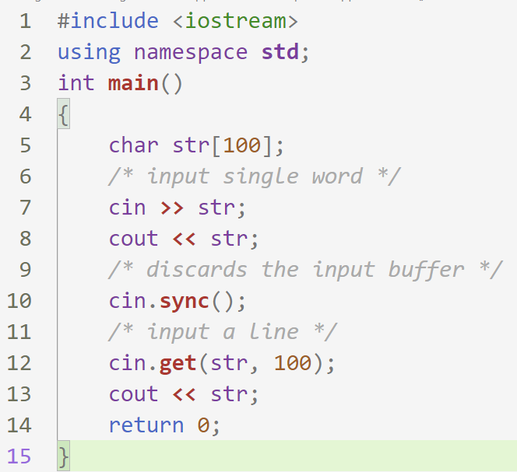
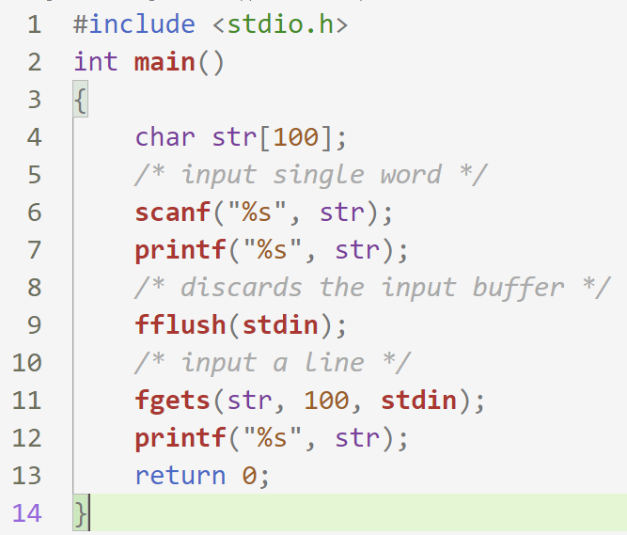
scanf(), printf() equivalent
which one is the C++ code?

Slide 9
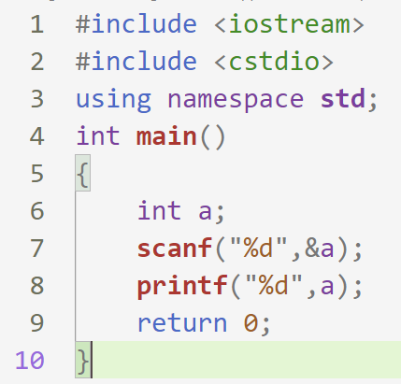
IF you prefer scanf(), printf() over cin, cout

Slide 10
Standard Template Library (STL)
STL is a set of C++ template classes to provide common programming data structures and functions such as lists, stacks, arrays, etc. It is a library of container classes, algorithms, and iterators.
We are going to use
Sorting
vector
priority queue

Slide 11
Vector
#include <vector>
To know more about vectors: https://www.edureka.co/blog/vectors-in-cpp/

Slide 12
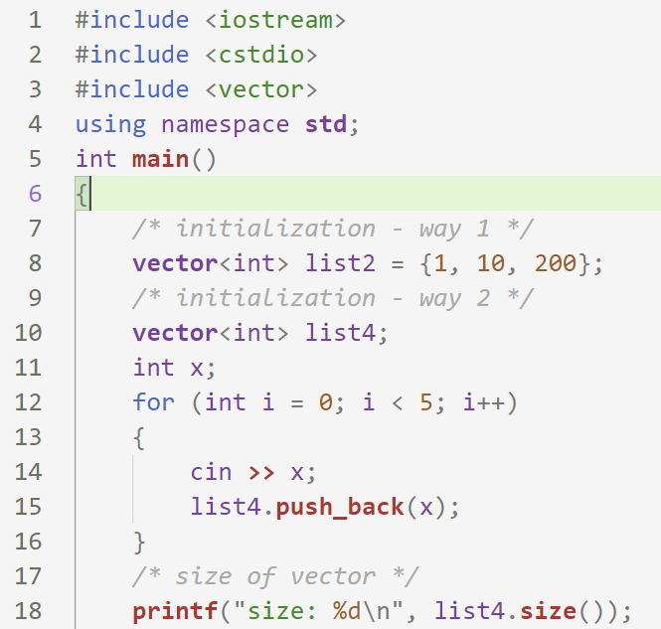
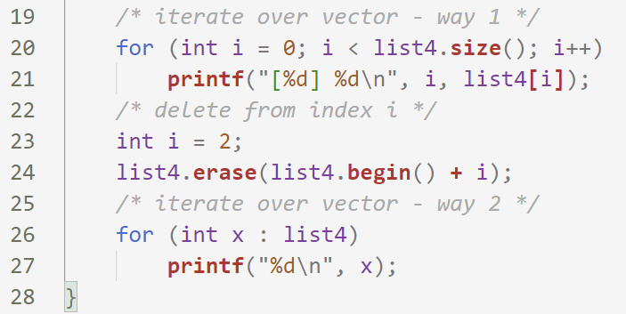
Vector
Vector
Input:
11 753 2 8 91
Output:
size: 5
[0] 11
[1] 753
[2] 2
[3] 8
[4] 91
11
753
8
91

Slide 13
Vector
Vector
#include <bits/stdc++.h>
Input:
11 753 2 8 91
Output:
size: 5
[0] 11
[1] 753
[2] 2
[3] 8
[4] 91
11
753
8
91

Slide 14
Sorting
sort array
sort vector
sort structure

Slide 15
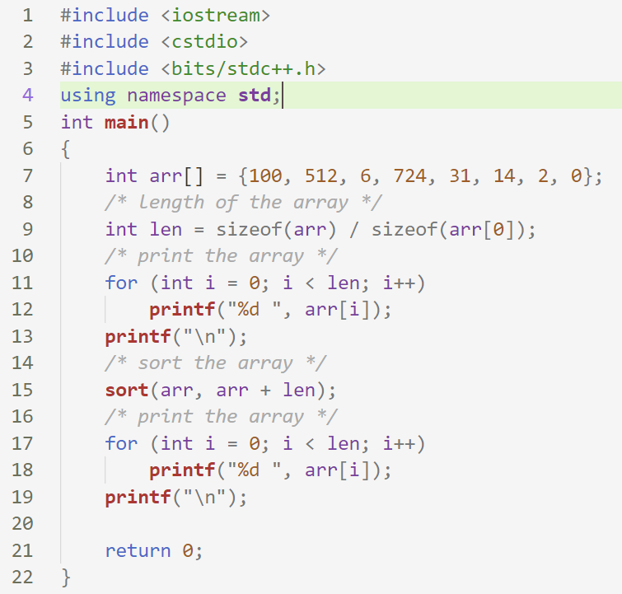
SORT Array
SORT Array
Output:
100 512 6 724 31 14 2 0
0 2 6 14 31 100 512 724
Default order/ Ascending order

Slide 16
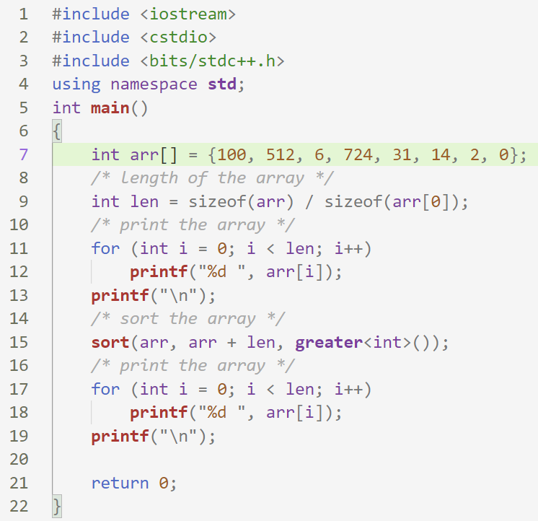
SORT Array
SORT Array
Output:
100 512 6 724 31 14 2 0
0 2 6 14 31 100 512 724
Output:
100 512 6 724 31 14 2 0
724 512 100 31 14 6 2 0
Default order/ Ascending order
Descending order

Slide 17
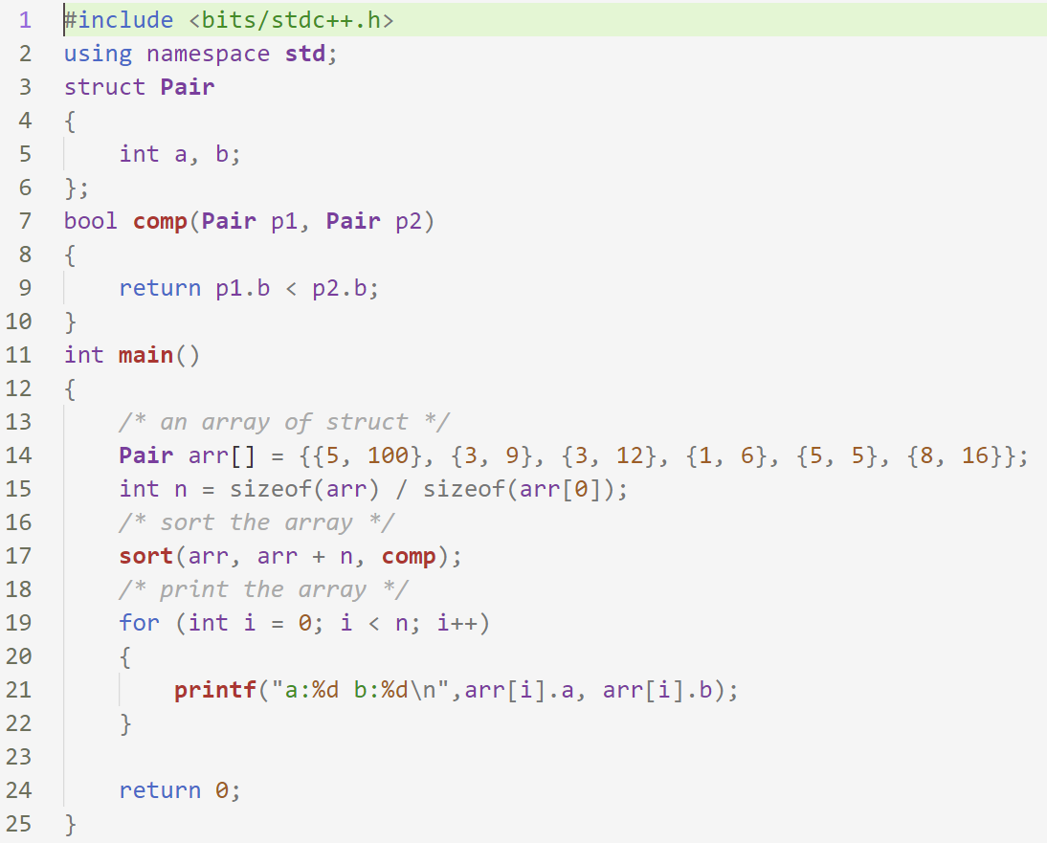
SORT Array
SORT Array of struct
Output:
a:5 b:5
a:1 b:6
a:3 b:9
a:3 b:12
a:8 b:16
a:5 b:100
this function is a must for sorting an array of struct
No default order. Order must be specified by a function

Slide 18
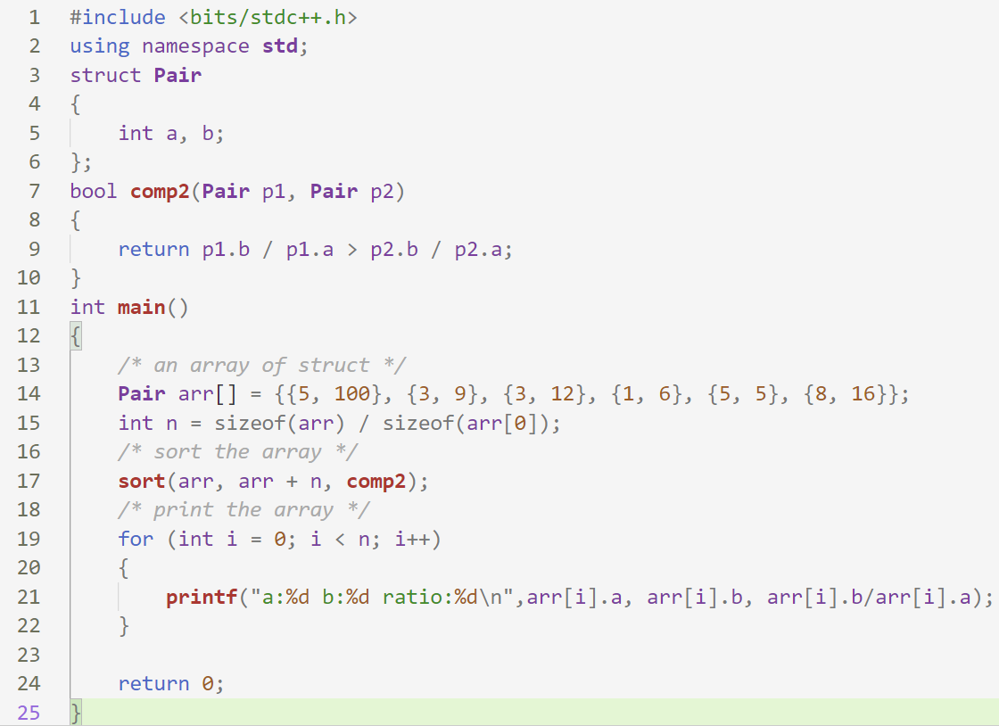
SORT Array
SORT Array of struct
Output:
a:5 b:100 ratio:20
a:1 b:6 ratio:6
a:3 b:12 ratio:4
a:3 b:9 ratio:3
a:8 b:16 ratio:2
a:5 b:5 ratio:1
No default order. Order must be specified by a function

Slide 19
String
In C++, string is an object of std::string class
It stores a sequence of characters.
e.g. “hello world”

Slide 20
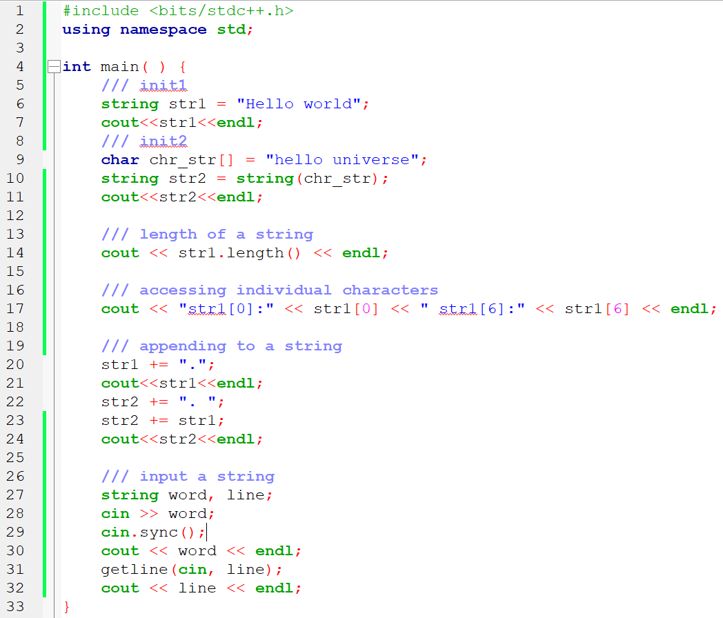
Input:
cpp strings
cpp strings
Output:
Hello world
hello universe
11
str1[0]:H str1[6]:w
Hello world.
hello universe. Hello world.
cpp
cpp strings

Slide 21
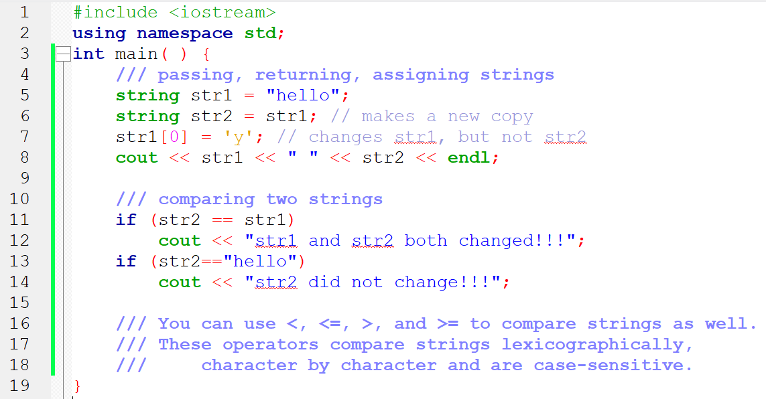
Output:
yello hello
str2 did not change!!!

Slide 22
String
Searching within a string.
search a character key: str.find(key)
returns the starting position of key
returns the constant string::npos if not found
search a string key: str.find(key)

Slide 23
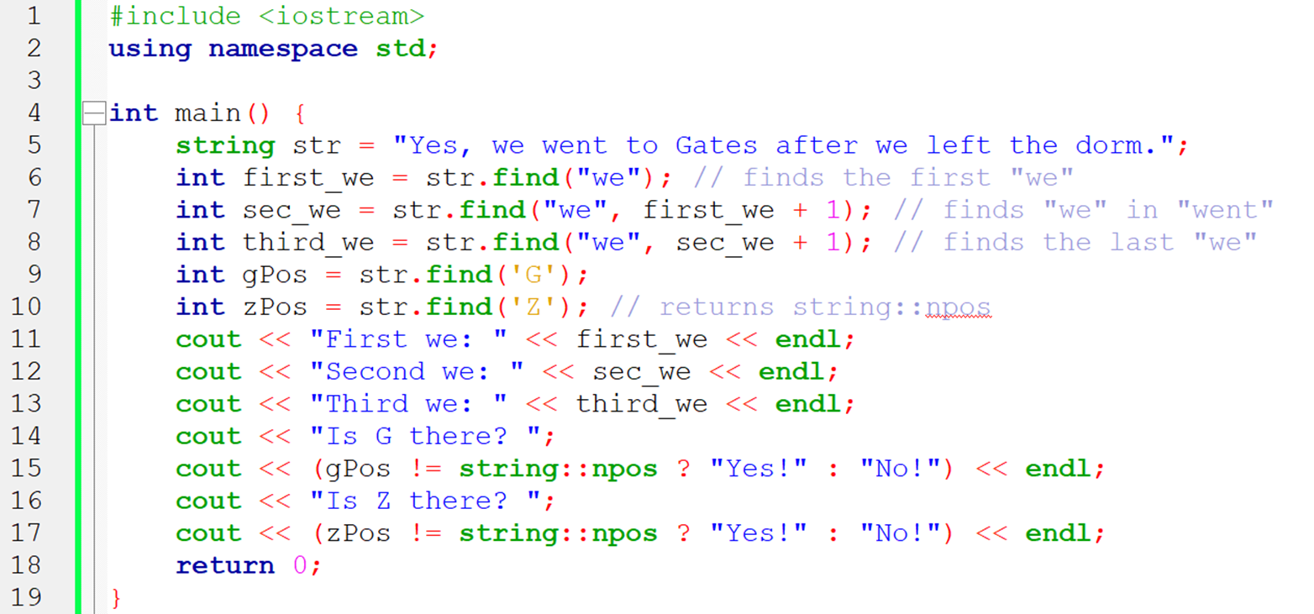
Output:
First we: 5
Second we: 8
Third we: 28
Is G there? Yes!
Is Z there? No!

Slide 24
String
Extracting substrings
str.substring(“hello”);

Slide 25
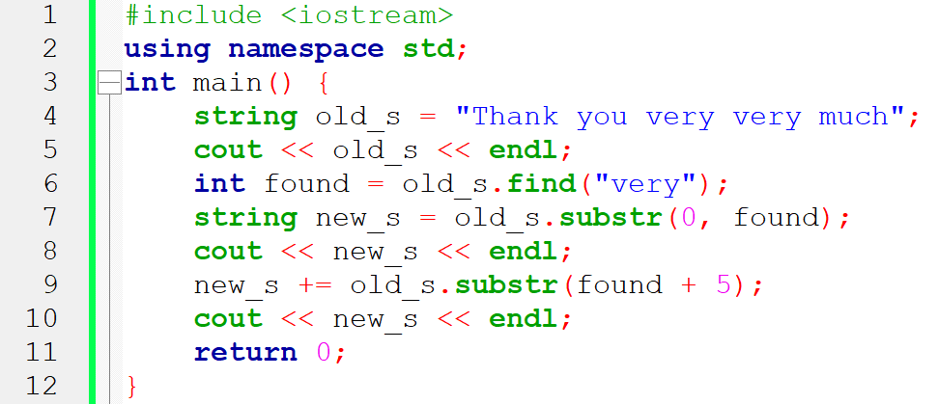
Output:
Thank you very very much
Thank you
Thank you very much

Slide 26
priority queue
A priority queue in c++ is a type of container adapter, which processes only the highest priority element, i.e. the first element will be the maximum of all elements in the queue, and elements are in decreasing order.
priority_queue<int> variableName;
min queue
priority_queue <int, vector<int>, greater<int>> q;

Slide 27
priority queue
p.empty()
p.size()
p.push(10) // insert 10
firstly, the element is added to the end of the queue, and simultaneously elements reorder themselves with priority. It takes value in the parameter.
p.pop()
deletes the top element (highest priority) from the priority_queue
p. top()
returns the top element (highest priority) from the priority_queue

Slide 28
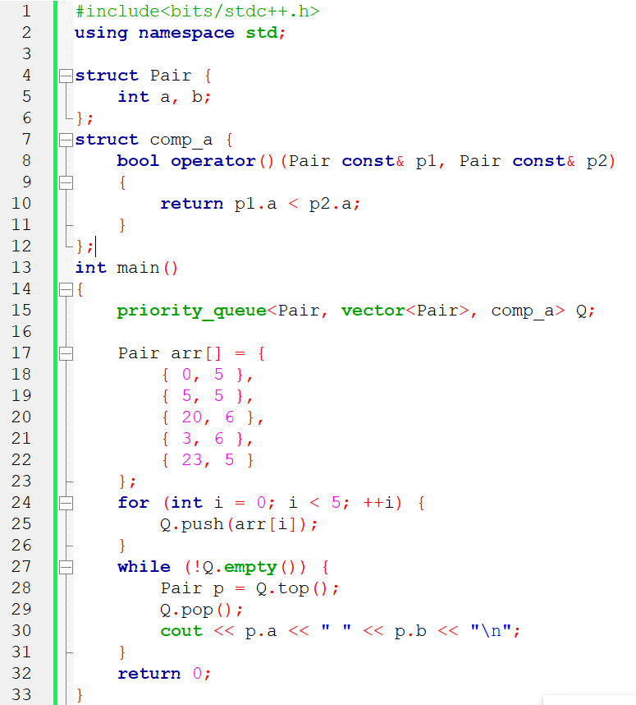
Output:
23 5
20 6
5 5
3 6
0 5

Slide 29
References
https://beginnersbook.com/2017/08/c-plus-plus-tutorial-for-beginners/
https://www.edureka.co/blog/vectors-in-cpp/
https://web.stanford.edu/class/archive/cs/cs106b/cs106b.1132/handouts/08-C++-Strings.pdf
https://www.mygreatlearning.com/blog/priority-queue-in-cpp/
https://www.geeksforgeeks.org/stl-priority-queue-for-structure-or-class/

